Slide 1
Object Oriented Programming for Data Science
AI based Classification and Regression Models
Priti Bhunia (11244222)
Jigisha Ahirrao (11222222)
Sonal Palrecha (11266082)
Navya Thirakala (11273787)
Venkatasumadhar Pabolu (11273758)
MAIT 2023-2025
03.11.2023 Industrial Internet of Things (IIoT) and Manufacturing Execution Systems (MES)
^{Seite 1} Prof. Dr. Felix Hackelöer, Institute of Automation & Industrial IT (AIT)

Slide 2
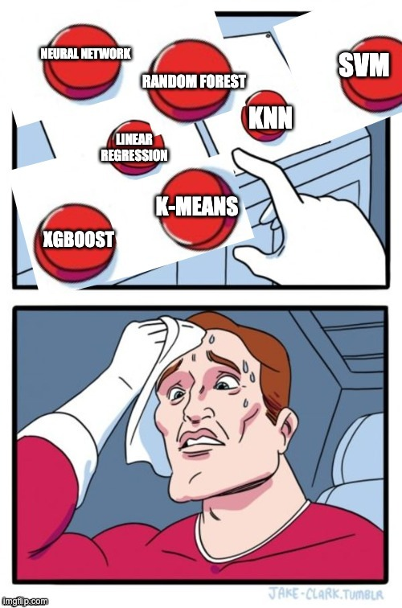

Slide 3
Agenda
Introduction
Evaluation Criterion
Random Forest
XGBoost
Neural Network
UML Diagram
GUI
Libraries

Slide 4
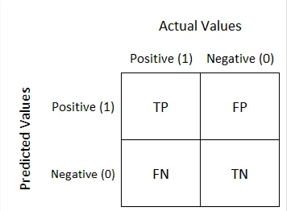
Evaluation criterion for classification
Accuracy
It is the ratio of the number of correct predictions and the total number of predictions.
Confusion Matrix
It is a performance measurement for
classification problem .
Source:https://towardsdatascience.com/understanding-confusion-matrix-a9ad42dcfd62

Slide 5
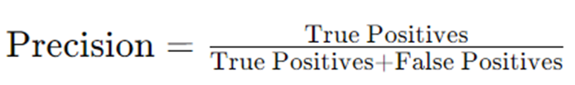

Evaluation criterion for Classification
Precision
Measures the fraction of relevant instances among the retrieved instances.
useful when false positives are costly.
Recall
Identifies the actual true predictions
from the actual positive samples.
Notes:
Precision : Precision measures the accuracy of positive predictions made by the model.
Recall :Recall measures the ability of the model to identify all positive instances.

Slide 6
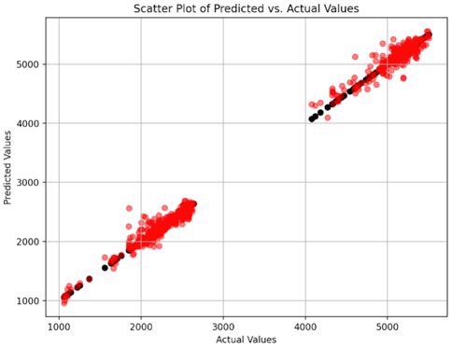
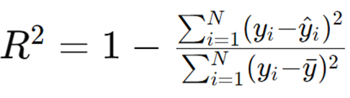
Evaluation Criterion for Regression
Scatter Plot
It is a dot representation of actual values (vs)
predicted values
R-squared (Coefficient of Determination)
Measures the proportion of the variance in the dependent variable that is predictable from the independent variables.
Indicates how well the independent variables explain the variability of the dependent
variable.
Notes:
R- squared is used in regression analysis to assess the goodness of fit of a regression model to the observed data.
It provides a measure of how well the independent variables explain the variability of the dependent variable.
R2 =0: The model does not explain any of the variability of the dependent variable around its mean. It indicates that the model does not fit the data at all.
R2=1: The model perfectly explains the variability of the dependent variable around its mean. It indicates that the model fits the data perfectly.

Slide 7
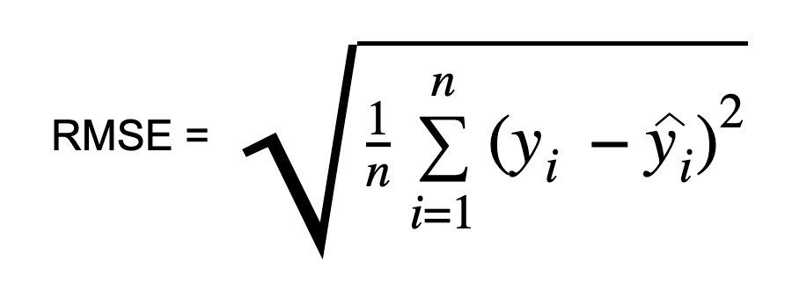
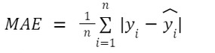
Evaluation Criterion for Regression
Root mean Squared error:
The Root Mean Squared Error (RMSE) is one
of main performance indicators for
a regression model.
Mean Absolute Error:
Calculates the Mean absolute error between
the true outcomes and predictions made by the
model.
Source: https://www.shiksha.com/online-courses/articles/mean-absolute-error/

Slide 8
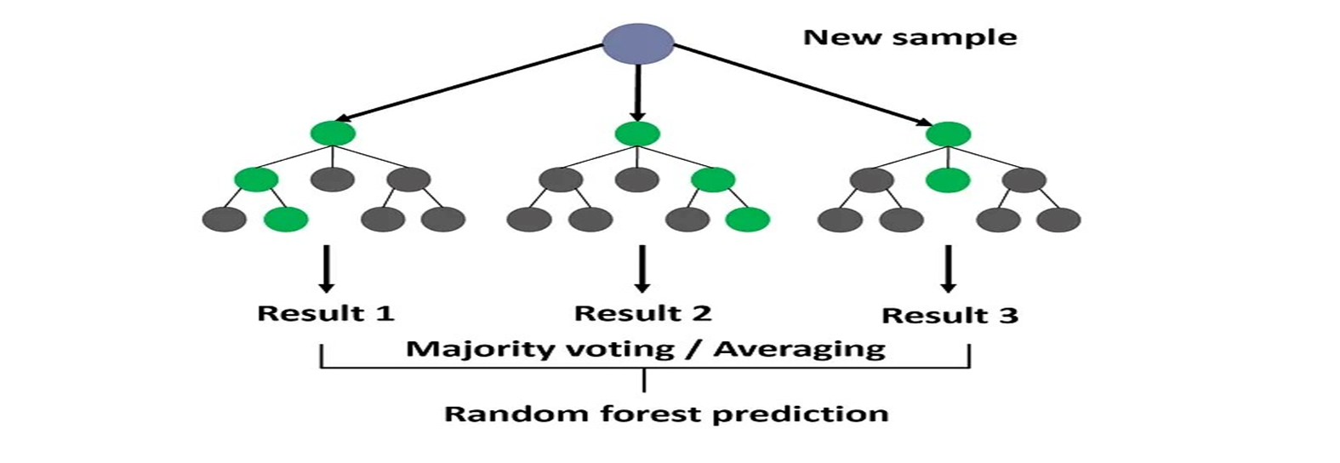
Random Forest
Source: https://medium.com/@roiyeho/random-forests-98892261dc49

Slide 9
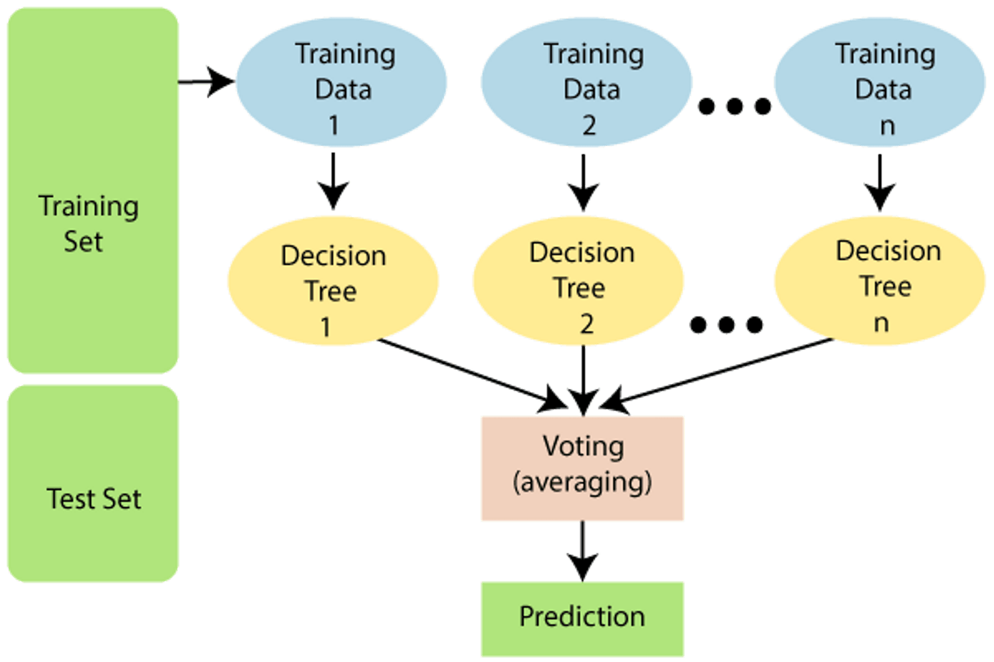
Train and Predict
Source:https://almablog-media.s3.ap-south-1.amazonaws.com/image_26_d14c96fe3a.png

Slide 10
Random Forest: Important Parameters
N_estimators
Criterion
max_Depth
Min_samples_split
Min_samples_leaf

Slide 11
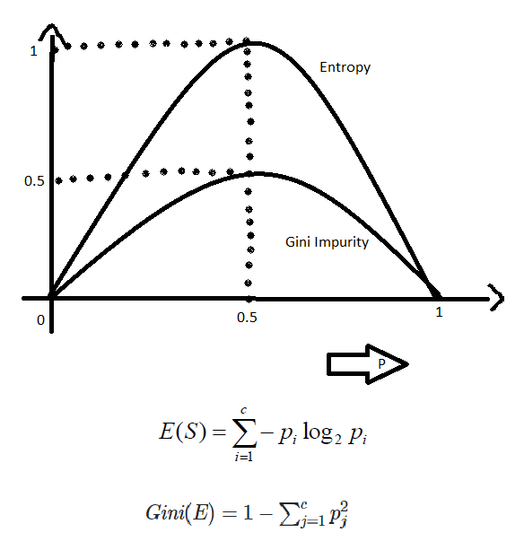
Criterion for Classification
Entropy
Gini
log_loss
Source: https://www.geeksforgeeks.org/gini-impurity-and-entropy-in-decision-tree-ml/

Slide 12
Criterion for Regression
Squared_error
friedman_mse
Poisson

Slide 13
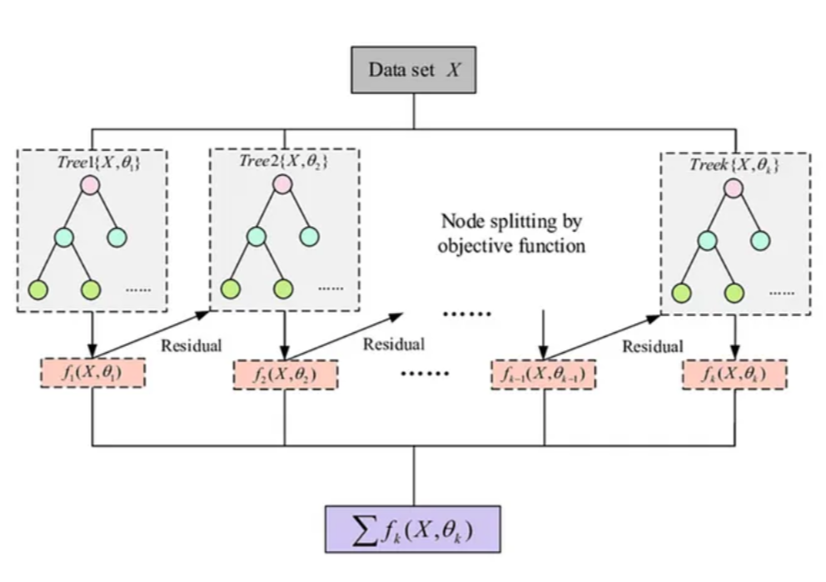
XGBOOST
source:https://easonlai888.medium.com/xgboost-or-logistic-regression-model-for-diabetes-prediction-1c3670cbbf6e

Slide 14
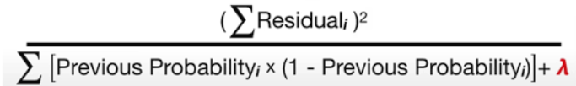
Internal formulas in XGBOOST
Similarity score for Classification:
Similarity score for Regression: (Sum of Residuals)^2 / (number of Residuals + λ )
Gain = Left similarity score + right similarity score -root similarity score
New Prediction = First Prediction + (Learning Rate)* (Second Prediction)
source:https://seanzhang-data.medium.com/boosting-techniques-for-machine-learning-xgboost-for-regression-and-classification-507376eedd6f

Slide 15
Parameters for Tree Booster
Learning_rate
It controls the step size at each iteration of the optimization process.
n_estimators
The number of boosting rounds (or iterations) to be performed during the training process.
max_depth
The maximum depth of each individual tree in the ensemble.

Slide 16
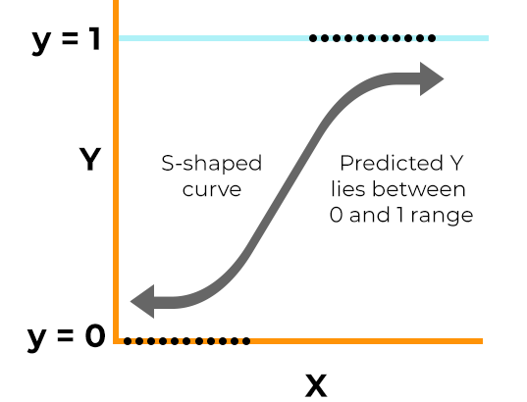
Objective Parameters for Classification
Logistic
Logitraw
Hinge
Image source: https://www.spiceworks.com/
Notes:
Logistic:
a probability close to 0 indicates high confidence in predicting the negative class, while a probability close to 1 indicates high confidence in predicting the positive class.
Hinge : This makes predictions of 0 or 1, rather than producing probabilities.

Slide 17
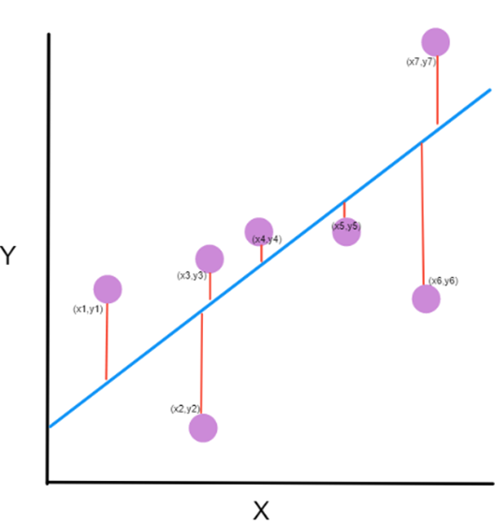
Objective Parameters for Regression
Squarederror
Squaredlogerror
It is a variant of the Mean Squared Error (MSE).
Image source : https://www.freecodecamp.org
Notes:
Squared loglosserror:
The squared logarithmic error function can be useful when dealing with tasks where the target variable spans several orders of magnitude, and you want to penalize large errors more heavily than small ones, but not as severely as with the squared error.

Slide 18
Neural Networks
INPUT
PREDICTION

Slide 19
Neurons and Activation Function
0.3
0.1
INPUT 1
f(x)=0.3
0.7
INPUT 2
Activation Function
0.5
Notes:
Neurons are something which provides an output value (usually between 0 and 1)
Depending on the input or pattern of the input, some neurons gets ‘activated’
The function which determines if the neurons gets activated or not is called activation function

Slide 20
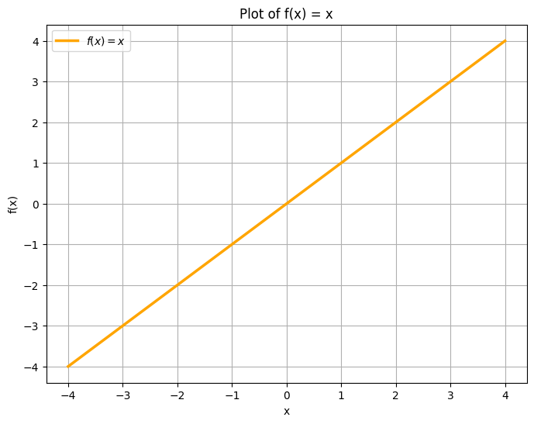
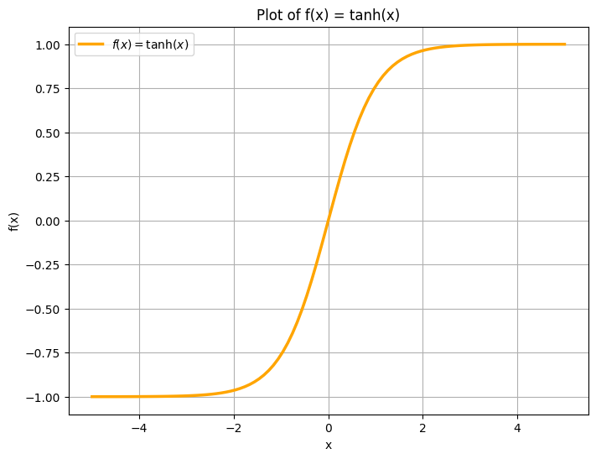
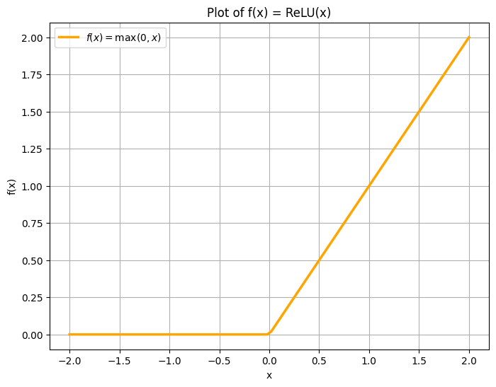
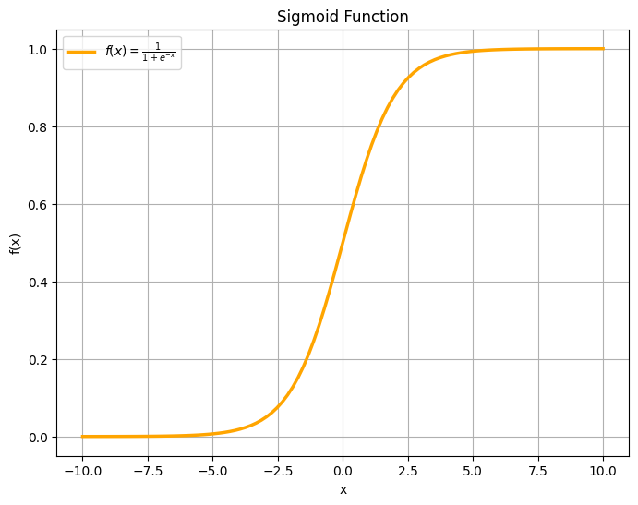
Activation Functions
Identity
f(x) = x
tanh
f(x) = tanh(x)
Logistic
f(x) = 1 / (1 + exp(-x))
ReLU
f(x) = max(0, x)

Slide 21
Layers
Input Layer
Hidden Layers
Output Layer
Holds value from the dataset
Holds patterns
Holds predictions

Slide 22
Weights
W11
W12
Training
W11
W14
W13
random weight
adjusted weight
Weights determine the strength of the connection between neurons

Slide 23
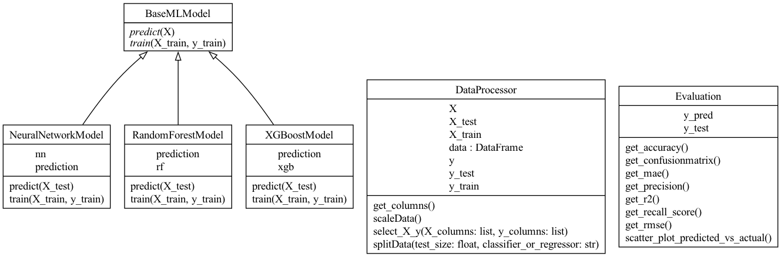
Backend UML Model

Slide 24



Libraries
Source: https://github.com/scikit-learn/scikit-learn?tab=readme-ov-file
Source: https://github.com/scikit-learn/scikit-learn?tab=readme-ov-file
Source: https://xgboost.readthedocs.io/en/stable/

Slide 25
DEMONSTRATION
MAIT 2023-2025
03.11.2023 Industrial Internet of Things (IIoT) and Manufacturing Execution Systems (MES)
^{Seite 1} Prof. Dr. Felix Hackelöer, Institute of Automation & Industrial IT (AIT)

Slide 26
Code Repository
https://github.com/pritibhunia/DataAnalyticsPlatform
MAIT 2023-2025
03.11.2023 Industrial Internet of Things (IIoT) and Manufacturing Execution Systems (MES)
^{Seite 1} Prof. Dr. Felix Hackelöer, Institute of Automation & Industrial IT (AIT)

Slide 27
Thank You! Questions?
MAIT 2023-2025
03.11.2023 Industrial Internet of Things (IIoT) and Manufacturing Execution Systems (MES)
^{Seite 1} Prof. Dr. Felix Hackelöer, Institute of Automation & Industrial IT (AIT)

